Slide 1

Secure Virtualized IT Platform with Containerized Applications
Group 10:
Mehmet, Puthyka, Jane, Zein, Roxana

Slide 2
PROJECT OVERVIEW
Design and implementation of a complete IT platform
Focus on integration of multiple infrastructure layers
Secure network architecture with firewall enforcement
Virtualization of operating systems using a hypervisor
Container-based application deployment
Emphasis on verification and testing

Slide 3
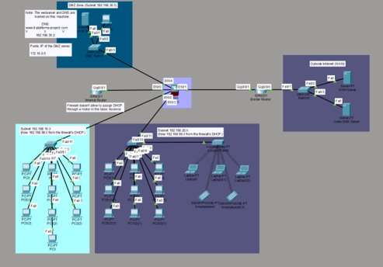
Network Topology and Design
ASA5505 firewall for security
Separation between the DMZ, and the inside and outside networks
Public web server accessible publicly from inside the DMZ

Slide 4
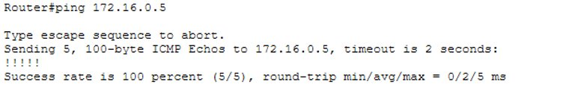





Network Configuration and Verification
DHCP service configured on the firewall for assigning IPv4's automatically
Dynamic NAT for outbound internet access (to 172.16.0.1 using ports)
Static NAT mapping for DMZ web server so that it's accessible
Access Control Lists limiting inbound traffic
ICMP (ping) inspection and connectivity testing

Slide 5
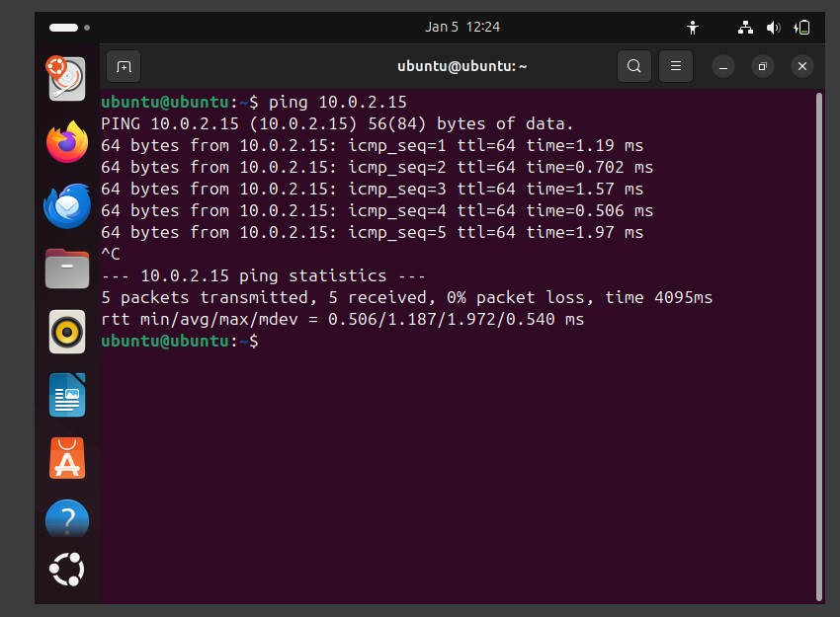
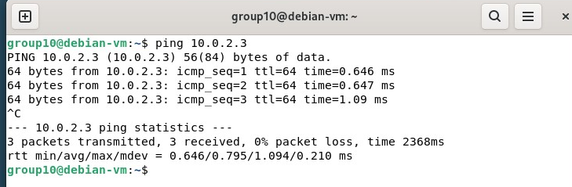
VIRTUALIZATION INFRASTRUCTURE
Oracle VirtualBox used as the virtualization platform
Multiple virtual machines running concurrently
Ubuntu virtual machine for application deployment
Debian virtual machine for multi-distribution support
Shared NAT Network configuration
Verified inter-VM network connectivity

Slide 6
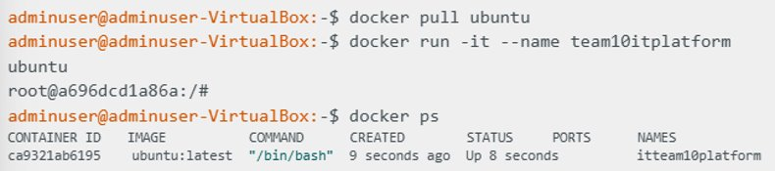
DOCKER PLATFORM IMPLEMENTATION
- Installation via official Docker repository on Ubuntu Virtual Machine
- Docker functionality verified
- Execution of Docker containers
- File system isolation demonstrated inside containers

Slide 7
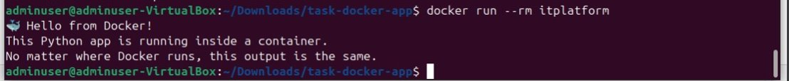
CUSTOM APPLICATION
CONTAINERIZATION
Development of a custom Python application
Minimal application logic for demonstration purposes
Dockerfile defining image build process
Reproducible Docker image creation
Container execution and output verification
Demonstration of application isolation

Slide 8

FLASK WEB APPLICATION DEPLOYMENT
Flask-based web application architecture
Containerized web service deployment
HTML templates used for server-side rendering
Port mapping for external access to the service
Environment variable used for runtime configuration
Dynamic webpage behavior without rebuilding images

Slide 9
TESTING AND PLATFORM INTEGRATION
Network layer tested for security and connectivity
Virtual machines tested for isolation and communication
Docker platform tested for container execution
Custom and web applications verified
End-to-end platform functionality confirmed
Integration of all infrastructure layers

Slide 10
CONCLUSION
Secure and segmented network infrastructure
Virtualized multi-operating system environment
Containerized application deployment
Use of modern IT platform technologies
Thank You!

